Slide 1
IOMT Capstone Project

Slide 2
Content
Research Paper: Smart IoT System for Longitudinal Real-time Physiological Monitoring of Cancer Patients Undergoing Treatment (pdf file included in the hardware drive)
This research highlights that cancer patients with health issues like sleep-disordered breathing, have higher death rates but this condition is often overlooked during treatment. Traditional sleep monitoring methods are uncomfortable and not suited for real-time use, and current home devices have limitations. The research present a smart IoT system for continuous, real-time monitoring of cancer patients' vital signs. It uses ESP32-based devices and cloud technologies like Apache Spark and Kafka for real-time data analysis, helping doctors respond quickly. Tested on head and neck cancer patients, the system offers a low-cost, user-friendly solution for at-home care.

Slide 3
Content
Hardware design:
https://drive.google.com/drive/folders/1ziWZ0m7-u6KCA5eKTg4JbgrxICob6gKq?usp=sharing
The folder includes BOM, CPL, and Gerber files necessary for ordering components. The design can be viewed and opened by using Eagle or KiCAD as well.

Slide 4
Content
Software design:
https://github.com/quocnh/OSA/tree/main
The code files for the system can be found in this github link (ESP32_to_Thingsboard), the newest version will be updated later by Ahmed.

Slide 5
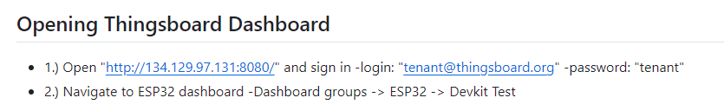
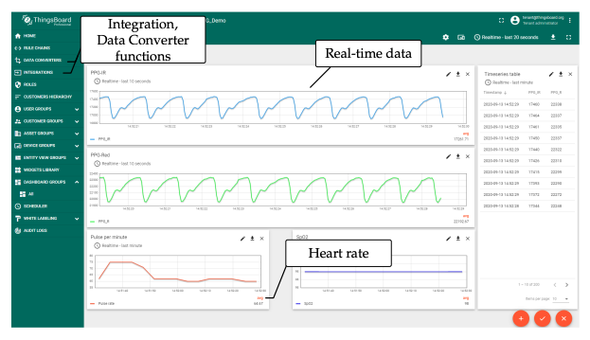
Thingsboard

